Slide 1
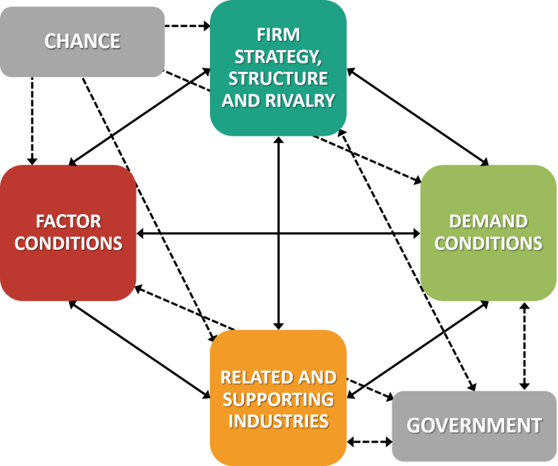
Chance;
Firm strategy;
Structure and rivalry;
Related supporting industries;
Demand conditions; and
Factor conditions.
https://www.business-to-you.com/porter-diamond-model/

Slide 2
Chance
  (What has created the opportunity.)
The high reliance on imported used vehicles and the need to establish an automotive industry in Senegal as identified by the Ministry of Industrial Development and Small and Medium Industries . Government has the political will to drive industrial development in Senegal and has identified the automotive industry development as a catalyst.
Growing middle class in the region making vehicle ownership more affordable as per capita GDP for the country and the region continues to grow.
Used vehicles are unsafe and environmentally unfriendly with high CO emissions. The drive to safer vehicles in Africa is supported by UNEP. Industry and region-wide engagements are aimed at creating an awareness of challenges with importing used vehicles.
Climate change and international policies re transport is driving the need for alternative drive trains for automotive industry in international markets. Senegal has the opportunity to establish an automotive industry addressing new drive trains such as EV while it is not hampered by legacy technologies and investments.
Senegal is in close proximity to EU markets that can be targeted in a local automotive manufacturing strategy.
ECOWAS will create a regional accessible market and value chain supported by regional free trade agreement (CET) while AfCFTA creates a large accessible continental market for automotive industry in Senegal.
Market opportunity. The proliferation of a relatively large population of used vehicles in the region, creates a market for after sales and replacement parts. The local manufacture of selected after sales automotive parts can provide the impetus for the establishment of an automotive industry in Senegal.
Implementation of the ECOWAS-wide unified approach to limiting the age of imported used vehicles to 5 years for light vehicles and 10 years for heavy vehicles will support demand for local manufacture of vehicles.

Slide 3
Firm Strategy
  (domestic rivalry is instrumental to international competitiveness, since it forces companies to develop unique and sustainable strengths and capabilities.)
Rivalry and competition in the domestic automotive industry in Senegal is currently limited due to the market being highly reliant on imported used and new vehicles. On the African continent, Morocco (with production of 248,430 vehicles in 2020), South Africa (447,218) and Egypt (23,754) are the major manufacturers of vehicles.
While internal competition in Senegal is limited, companies such as Seniran, Senbus (TATA) and CCBM, and Oniva (new project) are competing with imported vehicles and further afield in the ECOWAS region, Senegal competes with automotive manufacturers Nigeria, Cote D’ivoire and Ghana. Within the region, there is competitive industries eg VW in Ivory Coast etc.
The competitive environment in the region necessitates that newcomers have to produce quality products (vehicles) at competitive prices – thereby ensuring the development of the automotive industry along sound business principles.
The Senegalese and ECOWAS markets present unique challenges to the automotive industry and local vehicle assemblers such as Senbus and Seniran need to introduce vehicle characteristics that meet the local market requirements and conditions.
In the manufacture of selected automotive components, such as exhaust systems, brake components, tyres and rims, local companies can gain a competitive advantage due to being a local player in the market. Geographic presence and appreciation for local market conditions creates the opportunity to capitalise on the high demand for after sales and replacement automotive components.
Local manufacturers that produce steel- and textile-based products from local resources, could convert their production facilities to produce selected automotive components at relative low investment costs and thereby compete with imported replacement and spare parts.

Slide 4
Demand Conditions
  (larger market means more challenges, but also creates opportunities to grow and become better as a company. The presence of sophisticated demand conditions from local customers also pushes companies to grow, innovate and improve quality.)
Market demand in Senegal is limited with the total vehicle fleet estimated at 850,000 vehicles. However, the ECOWAS market represents a vehicle fleet of more that 9.6 million vehicles and growing. Countries such as Ghana, Senegal, Nigeria, Cape Verde and Cote d’Ivoire are amongst the attractive markets in the region.
Senegal’s new vehicle sales is projected to exceed 10,000 units per annum by 2025 (AAAM forecast) while new vehicle sales in the ECOWAS region amounted to just over 45,000 units in 2019 (AIH research).
Demand conditions are supported by projections of growth such as:
  annual GDP and population growth in excess of 3% and 2% respectively;
  A middle-class population growing in excess of 3% per annum;
  The vehicle density (vehicles/thousand people) is projected to grow from current 23/1000 to over 33/1000 by 2030; and
  Government support for creating a local automotive manufacturing industry through policies and local procurement will create an enabling environment.
The automotive industry in Senegal is well supported by dealers and distributors that have established networks throughout the country and that are able to provide vehicle maintenance and after sales support to the industry. As the industry moves to greater localisation of components and reducing age of imported used vehicles, these networks can be trained and educated to provide value added services.
Financing for vehicle purchases are still limited but institutions such as the Microfinance institutions (eg MECTRANS) are growing and specialises in the finance of transport solutions.
Industrial finance is available (eg from Development Finance Institutions) as well as incentives, to support investors in the establishment of new manufacturing capacity in Senegal.

Slide 5
Related and Supporting Industries
  (alliances and partnerships with other companies in order to create additional value for customers and become more competitive. Especially suppliers are crucial to enhancing innovation through more efficient and higher-quality inputs, timely feedback and short lines of communication.)
The automotive industry in Senegal (and ECOWAS) is still in its infancy and the country has the opportunity to establish a new automotive value chain in the automotive industry with international partners for component manufacture (Tier1 and 2) and OEMs for vehicle assembly. The industry will find support from:
Oil industry in Senegal – the establishment of an oil industry in Senegal will support the attractiveness of the Senegal as an investment destination due to its capability to provide raw materials (plastic industry) and capacity to earn forex.
Senegal has access to base minerals such as iron ore used in automotive component manufacturing. Titanium is used in ICE engine components and in alloys for weight reduction components. Rubber can be sourced from Cote d’Ivoire for tyres and windscreen wipers. Composite materials can be sourced from agriculture produce available in Senegal.
Training institutions – such as : École des Hautes Études Polytechnique de Dakar, École Polytechnique de Thiès for establishment of training courses in automotive industry.
The Senegalese PSE – infrastructure plan – that will create an enabling environment for investors in the automotive industry. Sustainable energy supply and good transport infrastructure are some of the drivers in the PSA.
Senegalese established financial institutions and insurers as well as Development Finance Institutions such as AfDB and Afreximbank that support industrial development in Senegal and the region.
Professional Associations and Bureau of Standards – vehicle / automobile association that support the automotive industry in Senegal.
Development of the informal sector – supports the growth of this sector in after sales services and parts distribution.
The established automotive retail industry that distribute new OEM vehicles and after sales parts and accessories
Logistic companies such as importers, freight forwarders with access to distribution network, e.g. the Port of Dakar and its capability to handle import (and export) of fully built vehicles.
Established industrial and Special Economic Zones with infrastructure and incentives to support investors in establishing new manufacturing industries.

Slide 6
Government
  (a catalyst and challenger‘. - governments should encourage and push companies to raise their aspirations and move to even higher levels of competitiveness. This can be done by stimulating early demand for advanced products (demand factors); focusing on specialized factor creations such as infrastructure, the education system and the health sector (factor conditions); promoting domestic rivalry by enforcing anti-trust laws; and encouraging change. The government can thus assist the development of the four aforementioned factors in the way that should benefit the automotive industry in a Senegal.)
The Senegalese government is an active supporter of industrial development and has implemented several initiatives to support the industry including:
  Development of an automotive policy framework which is underway;
  The implementation of used vehicle import constraints (currently being implemented), such as restricting the age of imported used vehicles; and
  Supporting free trade in automotive products under the CET in ECOWAS.
Amongst others, the Senegalese government Incentives for investments is aimed at attracting investors, such as lower company tax rates, duty relaxation on imported products for local manufacturing. The promotion of SEZ’s to multinational investors in the automotive industry can be a specific focus of the government in support of establishing an automotive industry in Senegal.
Training support is provided through initiatives such as the Academy of Commercial Vehicles and Heavy Engines (AGEVEC) in collaboration with UNIDO.
Investing in new and modern infrastructure covering electricity production and distribution, roads and other transport infrastructure, ICT etc. will ensure future sustainability of industrial development.
Providing a safe legal framework for business and investment and protection of intellectual property rights and a strong judiciary system is required by foreign investors introducing new manufacturing capacity and capability to Senegal.
Participating in regional trade initiatives such as the CET, which supports enhanced trade between ECOWAS member states.

Slide 7
Factor conditions
  (such as land, location, natural resources, labor, and population size as the primary determinants in a country's competitive economic advantage.)
Economic outlook for Senegal projects sustained growth for the Senegalese economy, which bodes well for the industries in the country and the establishment of an Automotive Policy FrameworkSize of the economy and its make-up: Industrial, manufacturing, agriculture and government.
A thriving industrial sector is required to establish and support the establishment of an automotive industry in Senegal. Currently industry contributes circa 24% to the GDP in Senegal and this provides a sound base from which to launch automotive component manufacturing and vehicle assembly projects.
Assessment of the population and demographics of Senegal reflects a growing population (17million people) and growing middle class. Senegal per capita GDP is just under US$1,500 while vehicle density is 48/1000. It has the 4th largest vehicle fleet in ECOWAS.
Labor and employment in Senegal still faces some headwinds. On the positive side, literacy rate is more than 40%. Unemployment is still high at ca 23% and notably youths and even university graduates are also affected. The Senegalese government is addressing these shortcomings through training initiatives and investments in infrastructure.
Natural resources in the country include iron ore and various agriculture products. The development of the oil extraction and processing industry in the country will provide employment opportunities and access to new raw materials such as fuels and other chemicals such as propylene and ethylene used in downstream chemical industries (plastics).
The presence of established manufacturing capabilities and capacities as well as the future outlook for new industrial capabilities provides an enabling and supportive industrial environment for the establishment of automotive industry component manufacture. The economic profile of most of the ECOWAS member states is very similar to that of Senegal with agriculture playing a dominant role. Inadequate infrastructure (energy, transport etc) hamper economic development in these countries and should Senegal’s PES implementation be successful, it will support the competitiveness of Senagal industrial capability in the region.

Slide 8
Position statement
The value proposition of Senegal includes:
  Its geographic location at the western end of the African continent and access to the Atlantic Ocean makes it ideal as a trade and economic hub linking Africa (ECOWAS) to Europe and the rest of the western world.
  A stable and secure political environment that focuses on good governance.
  Senegal has a large pool of young, educated labour that can be trained and skilled-up in providing a workforce for an automotive industry. The government devotes more than half of its annual budget to education and training.
  Developing word class infrastructure such as roads/railways, renewable energy investments, ICT and Special Economic Zones., According to the Worldbank Senegal is ranked 1st in logistics performance.
  Senegal’s investment code provides for incentives to boost investment in key sectors such as manufacturing.
  As an important member of the regional economic blocs, and thanks to its strategic position, Senegal is a gateway to a large market of more than 300 million consumers in Africa. It is a member of The West African Economic and Monetary Union (WAEMU)) ; Economic Community of West African States (ECOWAS)) ;The African Union (AU) ;The Organisation for the Development of the Gambia River(OMVG) ; And the Organisation for the Development of the Senegal River (OMVS).
  The epithet of "Teranga" country - the "World Economic Forum" has ranked Senegal 6th most welcoming country in the world, according to tourists.
  The business environment in Senegal is favourable and constantly improving. Since 2013, the Senegalese government has been implementing the Programme for the Reform of the Business Environment and Competitiveness (PREAC). This has created an enabling environment for investors.
No legacy of being encumbered by the past – Senegal can adopt new technologies and look forward to introducing advanced and modern, competitive manufacturing technologies in the manufacture if automotive components such e-plating and 3D printing. This could provide Senegalese manufacturing with opportunities to leapfrog its competitors in the region.

Slide 9
Position statement
Based on the value proposition of Senegal within the automotive industry, it is proposed that the Senegal automotive strategy is aimed at positioning the country in the following key areas:
  Vehicle marque for Senegal automotive assembly to include passenger vehicles, buses and mini-buses. Build on the current SKD assembly facilities in the country such as Seniran and Senbus and provide further support to these industries. Senegal can support expansion and investment in these companies, focused on conventional buses and mini-buses as well as a limited range of passenger vehicles. These assembly facilities can be further developed to increase the local content of the vehicles and provide market opportunity for locally manufactured components.
  Support local component assembly of selected automotive components such as automotive batteries. The access to a current battery manufacturing facility in Senegal can be used as a platform to support expansion of upstream component manufacture, eg plastic injection moulding for casings and lead processing for cells. Senegal is also well positioned to manufactured batteries for electric vehicles. Senegal’s proximity to other member states in the ECOWAS region, can be exploited to import raw materials for the local manufacture of automotive components and accessories. The development of refineries can lead to availability of plastic raw materials. Senegal can therefore also position itself as a key supplier of molded automotive components such as interior plastic components, hang-on exterior parts such as bumpers. The manufacture of selected automotive replacement parts, such as the batteries referred to above and other part such as windscreen wipers, can be encouraged
  Senegal can participate in the move in the automotive industry towards transition of ICE vehicles to electric vehicles. Electric vehicles require fewer components with less complexity. Senegal can position its automotive industry to be a player in electric mobility solutions by supporting transition of the current buses, minibuses and passenger vehicles to EV drive trains and other electric vehicles such as three-wheelers (last mile delivery and commuter transport) and electric motorbikes.
  Distributed energy supply using renewable energy. The development of the light electric vehicle industry in Senegal requires the support of electric charging infrastructure. Besides establishing the EV grid connectivity in urban areas, solar panels and battery backup can be used to provide micro-grid solutions in rural areas. These micro grids can support the deployment of electric motorbikes and electric three-wheelers in rural areas, thereby creating a sustainable solution in areas that are not readily serviced with access to grid electricity and other infrastructure.
  The proposed positioning needs to be supported by suitable policies (to protect the industry) and incentives (to encourage investment) from the Senegalese government to provide the enabling environment for the industry. Financial institutions are required to develop suitable investment and financing instruments to provide the industry with suitable financial support.

