Slide 1

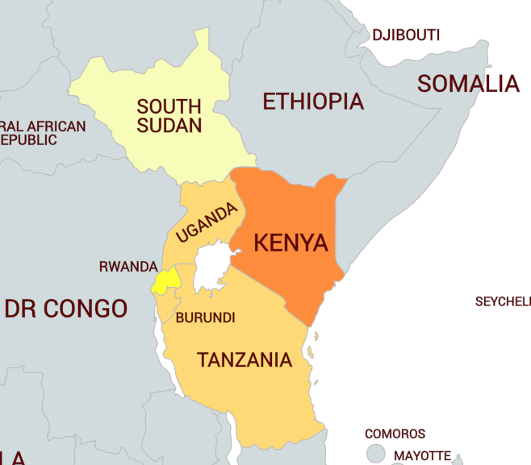

African Auto Pact Potential
East African Community + Ethiopia
15 July 2020
A report for the African Association of Automotive Manufacturers (AAAM)

Slide 2
Outline
EAC-Ethiopia Automotive Sector view– if the status quo continues
3
EAC-Ethiopia regional view – various scenarios, benefits of an Auto Pact and key conditions
4
African Auto Pact benefits for Hub and Spoke economies
5
Key objectives
1
Methodology and assumptions
2
Summary benefits
6

Slide 3

Objectives
To estimate the potential benefits of the Auto Pact in EAC + Ethiopia by:
  Applying the Auto Pact economic model to the region
  Quantifying the benefits to the hub and spoke economies and to the industry
  Outlining the conditions that have to be in place for the economic model to be realised
  Integrating this into the African Auto Pact context

Slide 4
Economic model
Four key assumptions:
Demand growth based on change in adult population earning more than $10,000 per year (new vehicle affordability threshold)
Pre-owned vehicle imports are banned (SA precedent)
Model assumes 20% absolute loss in vehicle demand from consumers who are no longer able to afford a vehicle
Production Equivalency Model (PEM) based on production being equivalent to local/regional consumption
METHODOLOGY ASSUMPTIONS
Production Equivalency Model (PEM)
Aggregate production values 2019-2035 Gross Value Addition (GVA - contribution to GDP) is calculated at 40% of production value (SA standard local content) 3 largest markets identified as hub economies: Kenya, Ethiopia, and Tanzania The rest allocated to the spoke economies Employment (vehicle and component manufacturing) Equivalent GVA/GVA per employee (SA standard). Employment was then split between vehicle and component manufacturing at a ratio of 1:3 (SA standard) Investment opportunities Annual new vehicle sales x $10,000 x average eight-year production run.

Slide 5
EAC-Ethiopia Auto Sector to 2035: if the status quo remains
Estimated new vehicle sales to 2035, based on existing market consumption profile
Status quo:
Fragmented SKD vehicle production in hubs, motorcycle assembly in Uganda, Yellow Metal assembly in Ethiopia
Underdeveloped componentry
Divergent policies regarding imports
 | 2018 | 2020 | 2026 | 2035
Burundi | 900 | 935 | 1 049 | 1 245
Kenya | 10 600 | 11 751 | 16 008 | 25 452
Rwanda | 522 | 592 | 862 | 1 517
South Sudan | 1 409 | 1 253 | 880 | 519
Tanzania | 4 500 | 5 062 | 7 204 | 12 232
Uganda | 4 000 | 4 408 | 5 898 | 9 129
Ethiopia | 8 030 | 9 565 | 16 166 | 35 519
EAC | 21 931 | 24 000 | 31 901 | 50 095
EAC plus Ethiopia | 29 961 | 33 565 | 48 067 | 85 614
Without an African Auto Pact or major policy interventions:
Small-scale SKD production will continue to grow at modest rate>> with limited component industry
Marginal growth in new vehicle sales>> pre-owned vehicles and grey imports will continue to dominate
Trade balance will continue to pose risk to the economies of the region
Estimated pre-owned vehicle imports to 2035, based on existing consumption profile
 | 2018 | 2020 | 2026 | 2035
Burundi | 1 529 | 1 589 | 1 782 | 2 116
Kenya | 77 341 | 85 737 | 116 797 | 185 709
Rwanda | 1 420 | 1 610 | 2 346 | 4 127
South Sudan | 3 832 | 3 407 | 2 395 | 1 412
Tanzania | 30 270 | 34 049 | 48 461 | 82 283
Uganda | 33 820 | 37 268 | 49 868 | 77 188
Ethiopia | 21 843 | 26 019 | 43 974 | 96 618
EAC | 148 212 | 163 659 | 221 648 | 352 834
EAC plus Ethiopia | 170 055 | 189 678 | 265 622 | 449 452
Notes:
2035

Slide 6
EAC-Ethiopia Auto Sector Demand to 2035: if imports are banned
Estimated EAC and Ethiopia new vehicle demand to 2035 if pre-owned vehicle imports were terminated
 | 2020 | 2026 | 2035
Burundi | 2 206 | 2 474 | 2 938
Kenya | 80 340 | 109 446 | 174 020
Rwanda | 1 879 | 2 739 | 4 818
South Sudan | 3 978 | 2 796 | 1 648
Tanzania | 32 301 | 45 973 | 78 058
Uganda | 34 222 | 45 792 | 70 879
Ethiopia | 30 380 | 51 345 | 112 814
EAC | 154 927 | 209 220 | 332 362
EAC plus Ethiopia | 185 307 | 260 565 | 445 176
The continued importing of pre-owned vehicles in large quantities is the major reason for limited new vehicle sales
In aggregate, the region is projected to import nearly 450,000 pre-owned vehicles by 2035, up from 170,055 units in 2018
Demand for new vehicles is estimated at 445,176 units by 2035 if pre-owned imports are terminated.

Slide 7




EAC-Ethiopia Auto Sector 2020 – 2035: full benefits of an Auto Pact
Benefits |  | 2020 | 2026 | 2035
Vehicle demand | Annual demand (units) | 185 307 | 260 565 | 445 176
 | Baseline production value (Billion $) | $1.85 | $2.61 | $4.45
Gross Value Added | Total Gross Value Added (Million $) | $741 | $1 042 | $1 781
 | Hub Economies GVA (Million $) | $572 | $805 | $1 375
 | Spoke Economies GVA (Million $) | $169 | $238 | $406
Employment | Total employment – Hub economies | 14 740 | 20 726 | 35 410
 | Total employment – Spoke economies | 4 609 | 6 481 | 11 072
 | Employment: vehicle assemblers | 4 335 | 6 095 | 10 414
 | Employment: component firms supplying assemblers | 8 671 | 12 192 | 20 830
 | Employment aftermarket componentry hub economies | 1 734 | 2 438 | 4 166
 | Employment aftermarket componentry spoke economies | 768 | 1 080 | 1 845
Investment | Total investment ($10,000 for each unit of annual production in Billion $) | $1.85 | $2.61 | $4.45

Slide 8



AUTO PACT: hub ECONOMY benefits 2035
Note that the GVA estimates are understated as they only include the direct economic impact of automotive production and do not factor in the full supply chain – GVA is more likely to be between 6% and 8% of GDP as per South Africa.
Kenya
Production type | Units | GVA per unit | Total GVA | GVA percent of GDP in 2018 | Employment
Semi Knocked Down (SKD): Status quo to 2035* | 174 020 | 4,00% | $67m | 0,11% | 4 478
Completely Knocked Down (CKD): Auto Pact to 2035* | 200 000 | 31,00% | $618m | 1,00% | 15 908
Ethiopia
Production type | Units | GVA per unit | Total GVA | GVA percent of GDP in 2018 | Employment
Semi Knocked Down (SKD): Status quo to 2035* | 112 854 | 4,00% | $44m | 0,07% | 2 903
Completely Knocked Down (CKD): Auto Pact to 2035* | 150 000 | 31,00% | $463m | 0,74% | 11 931
Tanzania
Production type | Units | GVA per unit | Total GVA | GVA percent of GDP in 2018 | Employment
Semi Knocked Down (SKD): Status quo to 2035* | 78 058 | 4,00% | $30m | 0,06% | 2 009
Completely Knocked Down (CKD): Auto Pact to 2035* | 100 000 | 31,00% | $309m | 0,59% | 7 954

Slide 9





AUTO PACT: EAC spoke ECONOMIES benefits
Country | GVA $millions (% of GDP in 2018)
 |  | Employment at component manufacturers | Aftermarket component employment spill-over | Total industry employment estimate
Burundi | 53 (2.27%) | 1 216 | 243 | 1 459
Rwanda | 31 (0.31%) | 705 | 141 | 846
South Sudan | 84 (n/a) | 1 903 | 381 | 2 283
Uganda | 238 (0.78%) | 5 403 | 1 081 | 6 484
Total | 406 | 9 227 | 1 845 | 11 072

Slide 10
Critical conditions to achieve the economic benefits of the model
Banning pre-owned vehicle imports
Auto Pact incentive structure
Trading between other hubs
3-4 CKD plants in hubs
Investment into CKD plants to achieve economies of scale
Kenya, Ethiopia, Tanzania: producing between 80,000 and 100,000 units per plant
Spoke economies as Tier 1 and Tier 2
Also motorcycles and yellow metals
Including South Africa, Ghana, Nigeria
To service regional and export markets
ECONOMIC BENEFITS
TIME

Slide 11

Key policy considerations
Accepting the economic logic of working with a larger region in the form of the EAC and Ethiopia
Ensuring that the Kenyan Automotive Policy includes a reduction in pre-owned imports or a more expedited process to reduce the age of vehicle imports
Developing a harmonised duty and incentive structure between EAC and Ethiopia, by including automotive products in the higher band of the revised EAC CET (to 30% or 35%).
Attracting component and complementary manufacturing investments into spoke economies, to ensure the establishment of a regional production dynamic of benefit to all participating economies

Slide 12
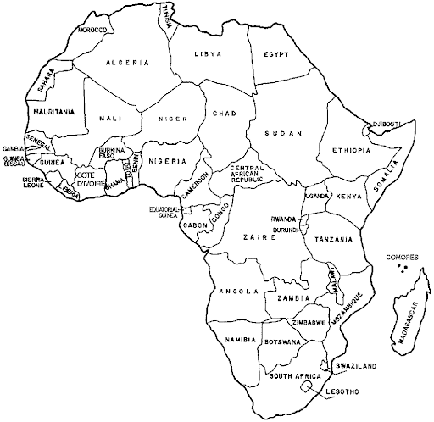
African Auto Pact Overview
USA&EU
Middle East
An integrated market of interlinked production hubs that trade within the AfCFTA and regional agreements and continuing exports to traditional markets: EU, Middle East etc, based on:
Coordinated production of a variety of vehicle models
Policies dealing with second-hand imports
Harmonised standards, homologation, vehicle ID systems
Building up component manufacturing in spoke economies in each sub-region
Asset-based vehicle finance products throughout the continent
Government procurement schemes for Programme fleet and other demand-side measures
Expanding to motorcycle and yellow metals manufacturing
EAC + Ethiopia
400,000 units
ECOWAS
500,000 units
South Africa
1,400,000 units

Slide 13


Questions
Political economy related:
  Alec Erwin – Alece@ubuholdings.co.za
Automotive market and production related:
  Prof Justin Barnes – justin@bmanalysts.com; justin.barnes@twimsafrica.com

Slide 14
APPENDICES: Detailed BENEFITS: HUB AND SPOKE COUNTRIES

Slide 15
Status quo of Kenyan auto sector
Indicator | Values
Population 2018* | 51 million
GDP per capita PPP 2018 (nominal)* | 1 711
Total number of vehicles in operation (2015) † | 1.381 million
Estimated ratio of people to vehicles | 30 per 1,000
Passenger vehicle production (2018ⁱ) | 6 295
Passenger vehicle sales (2016) | 2 400
Commercial vehicle sales (2016) | 8 200
Kenya’s GDP growth rate averaged 5.6% over the period 2009 to 2018
Kenya’s automotive trade deficit was $3.7 billion in 2018
High levels of imported vehicles continues to put a strain on foreign currency reserves
3% of Kenya’s adult population earned over $10,000 annually in 2017, this is 650,000 people
Only 10,600 new vehicles were sold in 2018. This is a result of pre-owned vehicle sales capturing the market
Source: *World Bank http://data.worldbank.org/; †OICA http://www.oica.net/category/vehicles-in-use/; ⁱOICA production and sales http://www.oica.net/category/production-statistics/; http://www.oica.net/category/sales-statistics

Slide 16
Kenya demand for new vehicles
Kenya adjusted new vehicle demand to 2035 (with no pre-owned vehicle imports)
If Kenya were to eliminate pre-owned vehicle imports then we estimate that the demand for new vehicles would be 80,340 in 2020, increasing to 174,020 units by 2035
Notes: Based on the termination of pre-owned vehicle imports and substitution with new vehicles (and demand reduced by 20% for affordability reasons).

Slide 17
Kenya vehicle production: SKD to CKD opportunity
Production type | Units | GVA per unit | Total GVA | Employment
Semi Knocked Down (SKD): Status quo to 2035* | 174 020 | 4,00% | $67m | 4 478
Completely Knocked Down (CKD): Auto Pact to 2035* | 200 000 | 31,00% | $618m | 15 908
Direct benefit of CKD production to Kenya relative to SKD assembly* | 25 980 | 27,00% | $551m | 6 685
Kenya has launched a new draft National Automotive Policy
The AAAM has made recommendations on priority interventions regarding key policy measures: TRIM, policy on second-hand vehicles, standards and homologations etc.
* Per assembly of US$10,000 vehicle; local market substitution only for SKD; regional market for CKD

Slide 18
Status quo of Ethiopian auto sector
Indicator | Values
Population 2018* | 108 million
GDP per capita PPP 2018 (nominal)* | 772
Total number of vehicles in operation† | 155 000
Estimated ratio of people to vehicles (per 1,000) | 2
Passenger vehicle production (2018ⁱ) | 6 000
Total new vehicle sales (2018) | 8 030
Ethiopia’s GDP growth rate averaged 9.8% over the period 2009 to 2018
Ethiopia’s automotive trade deficit was $277 million in 2018
Cumulative taxes on imported vehicles may reach 200% depending on the type of vehicle
4.77% of the adult population earns >$10,000, this is 2.39 million adults in 2017
Only 8,030 new vehicles were sold in 2018. Due to pre-owned vehicles capturing the market
Source: *World Bank http://data.worldbank.org/; †OICA http://www.oica.net/category/vehicles-in-use/; ⁱOICA production and sales http://www.oica.net/category/production-statistics/; http://www.oica.net/category/sales-statistics

Slide 19
Ethiopia demand for new vehicles
Ethiopia adjusted new vehicle demand to 2035 (with no pre-owned vehicle imports)
If Ethiopia were to halt pre-owned vehicle imports, the demand for new vehicles would be 30,380 in 2020, increasing to 112,814 units by 2035
Notes: Based on the termination of pre-owned vehicle imports and substitution with new vehicles (and demand reduced by 20% for affordability reasons).

Slide 20
Ethiopia vehicle production: SKD to CKD opportunity
Production type | Units | GVA per unit | Total GVA | Employment
Semi Knocked Down (SKD): Status quo to 2035* | 112 854 | 4,00% | $44m | 2 903
Completely Knocked Down (CKD): Auto Pact to 2035* | 150 000 | 31,00% | $463m | 11 931
Direct benefit of CKD production to Ethiopia relative to SKD assembly* | 37 146 | 27,00% | $419m | 9 028
While GDP growth averaged 9.8% over the period 2009 to 2018, Ethiopia has one of the lowest motorisation rates globally
High population growth – high potential demand brought upon by economic growth
Pre-owned vehicles dominate sales – a policy dealing with this is critical to managing the consequences of a negative trade balance
* Per assembly of US$10,000 vehicle; local market substitution only for SKD; regional market for CKD

Slide 21
Status quo of Tanzanian auto sector
Indicator | Values
Population 2018 | 59 million
GDP per capita PPP 2014 (nominal)* | 1 051
Total number of vehicles in operation† | 380 000
Estimated ratio of people to vehicles (per 1000 people) | 7 per 1000
Passenger vehicle production (2015ⁱ) | -
Passenger vehicle sales (2016) | 2 300
Commercial vehicle sales (2016) | 2 200
Tanzania’s GDP growth rate averaged 6.3% over the period 2009 to 2018
Tanzania’s automotive trade deficit was $369 million in 2018
High levels of imported vehicles continues to put a strain on foreign currency reserves
5,25% of the adult population earns >$10,000, this is 1.34 million adults
Only 4,500 new vehicles were sold in 2018. This is due to pre-owned vehicle capturing the market
Source: *World Bank http://data.worldbank.org/; †OICA http://www.oica.net/category/vehicles-in-use/; ⁱOICA production and sales http://www.oica.net/category/production-statistics/; http://www.oica.net/category/sales-statistics

Slide 22
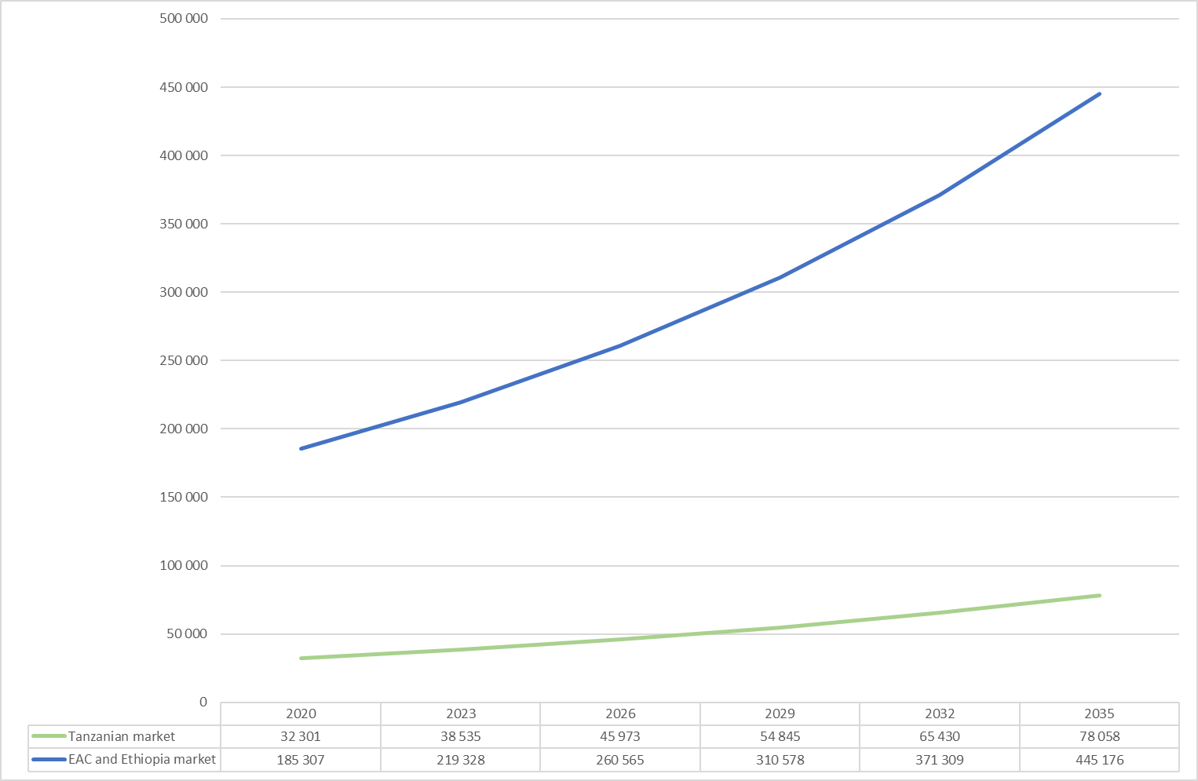
Tanzania demand for new vehicles
Tanzania adjusted new vehicle demand to 2035 (with no pre-owned vehicle imports)
If Tanzania were able to halt pre-owned vehicle imports then we estimate that the demand for new vehicles would be 32,301 in 2020, increasing to 78,058 units by 2035
Notes: Based on the termination of pre-owned vehicle imports and substitution with new vehicles (and demand reduced by 20% for affordability reasons).

Slide 23
Tanzania vehicle production: SKD to CKD opportunity
Production type | Units | GVA per unit | Total GVA | Employment
Semi Knocked Down (SKD): Status quo to 2035* | 78 058 | 4,00% | $30m | 2 009
Completely Knocked Down (CKD): Auto Pact to 2035* | 100 000 | 31,00% | $309m | 7 954
Direct benefit of CKD production to Tanzania* | 21 942 | 27,00% | $279m | 5 945
Tanzania’s auto market is dominated by pre-owned vehicle imports and will face severe trade balance constraints without a policy intervention
Based on the domestic demand of 78,058 units in 2035, and the broader EAC demand of 445,176 units, the potential for Tanzanian vehicle production is 100,000 units/year by 2035
Assuming CKD production with 31% (76% of 40% GVA per unit of production) local GVA, the production of 100,000 vehicles in Tanzania would translate into total annual GVA of $309 million
The benefits would translate into 7,954 high quality jobs by 2035.
* Per assembly of US$10,000 vehicle; local market substitution only for SKD; regional market for CKD

Slide 24
African Auto Pact benefits to the EAC spoke economies
Direct benefit to spoke economies in 2035
 | Adjusted annual units of demand | GVA ($millions) | Employment at component manufacturers | Aftermarket Component Employment spill over | Total Industry Employment estimate
Burundi | 2 938 | 53 | 1 216 | 243 | 1 459
Rwanda | 4 818 | 31 | 705 | 141 | 846
South Sudan | 1 648 | 84 | 1 903 | 381 | 2 283
Uganda | 70 879 | 238 | 5 403 | 1 081 | 6 484
Total | 80 284 | 406 | 9 227 | 1 845 | 11 072
Spoke economy production
Burundi exported c$90k worth of miscellaneous P&A in 2018 (HS 8708)
Uganda exported around $1m worth of vehicle parts and accessories (HS 8708) in 2018
No component trade data for Rwanda from 2017 but 2016 data suggests that Rwanda potentially may have some capabilities in miscellaneous P&A and in some tyre production
Spoke economies vehicle consumption is relatively small (combined 24% of total EAC sales) and follows the same dynamic
Spoke economies would employ 9,227 people in component manufacturing operations (for the vehicle assemblers) and 1,845 in aftermarket- related component activities.

Slide 25
African Auto Pact Benefits: motorcycle and yellow metals opportunities
EAC and Ethiopian trade balance of motorcycles by country, units (2018)
EAC and Ethiopian exports and imports of agriculture, mining, and construction equipment by country, units (2018)
Uganda exported c21k motorcycles in 2018, with SKD assembly through Simba Automotives
There is agriculture, mining, and construction equipment manufacturing in Ethiopia, most likely through Bishoftu Automotive Industry (BAI)

Slide 26
BACK-UP SLIDE 1: EAC-Ethiopia Trade Agreements
EAC
Ethiopia
The current EAC Common External Tariff (CET) is based on three bands: 25% for finished goods, 10% for intermediate goods and 0% for raw materials and capital goods
The EAC CET is currently under review, with members considering higher rates of external protection and an increase in the number of tariff bands
Opportunity: including automotive products in the higher band of the revised EAC CET (to 30% or 35%)
Ethiopia's accession to the World Trade Organization (WTO)
Ethiopia is also a signatory to the Common Market for Eastern and Southern Africa (COMESA), the Intergovernmental Authority on Development (IGAD), the European Union (EU) Economic Partnership Agreement (EPA)

Slide 27
BACK-UP SLIDE 2: Overview of current assembly capacity in Kenya
Assembly plant | Brands and franchise holder |  | Capacity utilization
Isuzu East Africa Limited Nairobi | ISUZU EA–Isuzu |  | 23%
Associated Vehicle Assemblers Mombasa | SIMBA CORP– Mitsubishi, FUSO TATA – Tata Toyota East Africa – Toyota, Hino Kenya Grange – Scania Foton – Foton, Aumark Volvo – Volvo Daewoo |  | 35%
Kenya Vehicle Manufacturers (KVM) Thika | COOPER MOTORS CORPORATION - Nissan Diesel, Eicher, MAN Crown Motors – Nissan Peugeot (PSA Group) – Peugeot Volkswagen – Volkswagen Bus Body Building - 33-seater bodies for Hyundai, Eicher, Isuzu, Mitsubishi; 51-seater bodies for UD, TATA, Hino; 62-seater bodies for Scania, MAN, Ashok Leyland |  | 2%
National Average Utilization |  | 20%
Kenya has three local assemblers: The Isuzu plant in Nairobi, the Associated Vehicle Assemblers (AVA) plant in Mombasa and the Kenya Vehicle Manufacturers (KVM) plant in Thika
These assemblers collectively produce around 6,000 cars per annum, but they are operating significantly below installed capacity
The national average capacity utilisation of auto manufacturing plants is only 20%
Source: Kenya National automotive Policy (2019)

Slide 28
Back-up slide 3: Overview of current assembly capacity in Ethiopia
Assembler | Location | Annual capacity | Brands | Type of vehicle
Bishoftu Automotive Industry (BAI) | Bishoftu | 4 000 | Bishoftu, FAW | Passenger vehicles, LCV, HCV
Betret International | Adama | 1 200 | BYD Auto | Passenger vehicles
Yang Fan Dukem | Eastern Industry Zone | 1 000 | Lifan | Passenger vehicles
Mesfin | Industrial Engineering Mekelle | 1 000 | Geely Passenger vehicles license | Passenger vehicles
Automotive Manufacturing Company of Ethiopia (AMCE) | Addis Ababa | 600 | IVECO | HCV
Belayab Engineering | Adama | 500 | FAW | HCV
Nigma Motors and ZAZ | Gulele | 300 | Nigma (produce Daewoo, Chevrolet under license) | Passenger vehicles
It is estimated that Ethiopia produced around 6,000 passenger vehicles in 2018
Bishoftu Automotive Industry (BAI) is the largest automotive manufacturer in Ethiopia>> BAI manufacturers and assembles heavy armament, tanks, and military vehicles
Several private sector players perceive BAI to be difficult to compete against as state supported assemblers’ benefit from government projects (Deloitte, 2018)
Source: Deloitte (2018)

Slide 29


BACK-Up SLIDE 4: Other Markets in the EAC
Tanzania
Rwanda
IPP Automobile Company Ltd signed an agreement with a South Korean firm, Youngsan Glonet Corporation, in 2018 to set up a vehicle assembly plant in Tanzania (Forbes, 2018).
The $10 million facility is expected to assemble around 1,000 vehicles per year, including commercial and construction trucks, buses, and sports utility vehicles (SUVs). The plant is expected employ more than 1,000 people including distribution and sales executives
VW established a SKD car assembly plant in Rwanda in 2018
Plant is currently producing the VW Polo model in the 1st phase but VW plans to reach annual production of 5,000 cars by also assembling its Passat, Tiguan, Amarok and Teramont models in the plant
The plant uses components shipped from SA. The $20m investment is expected to create up to 1,000 jobs (Reuters, 2018)

